Slide 1
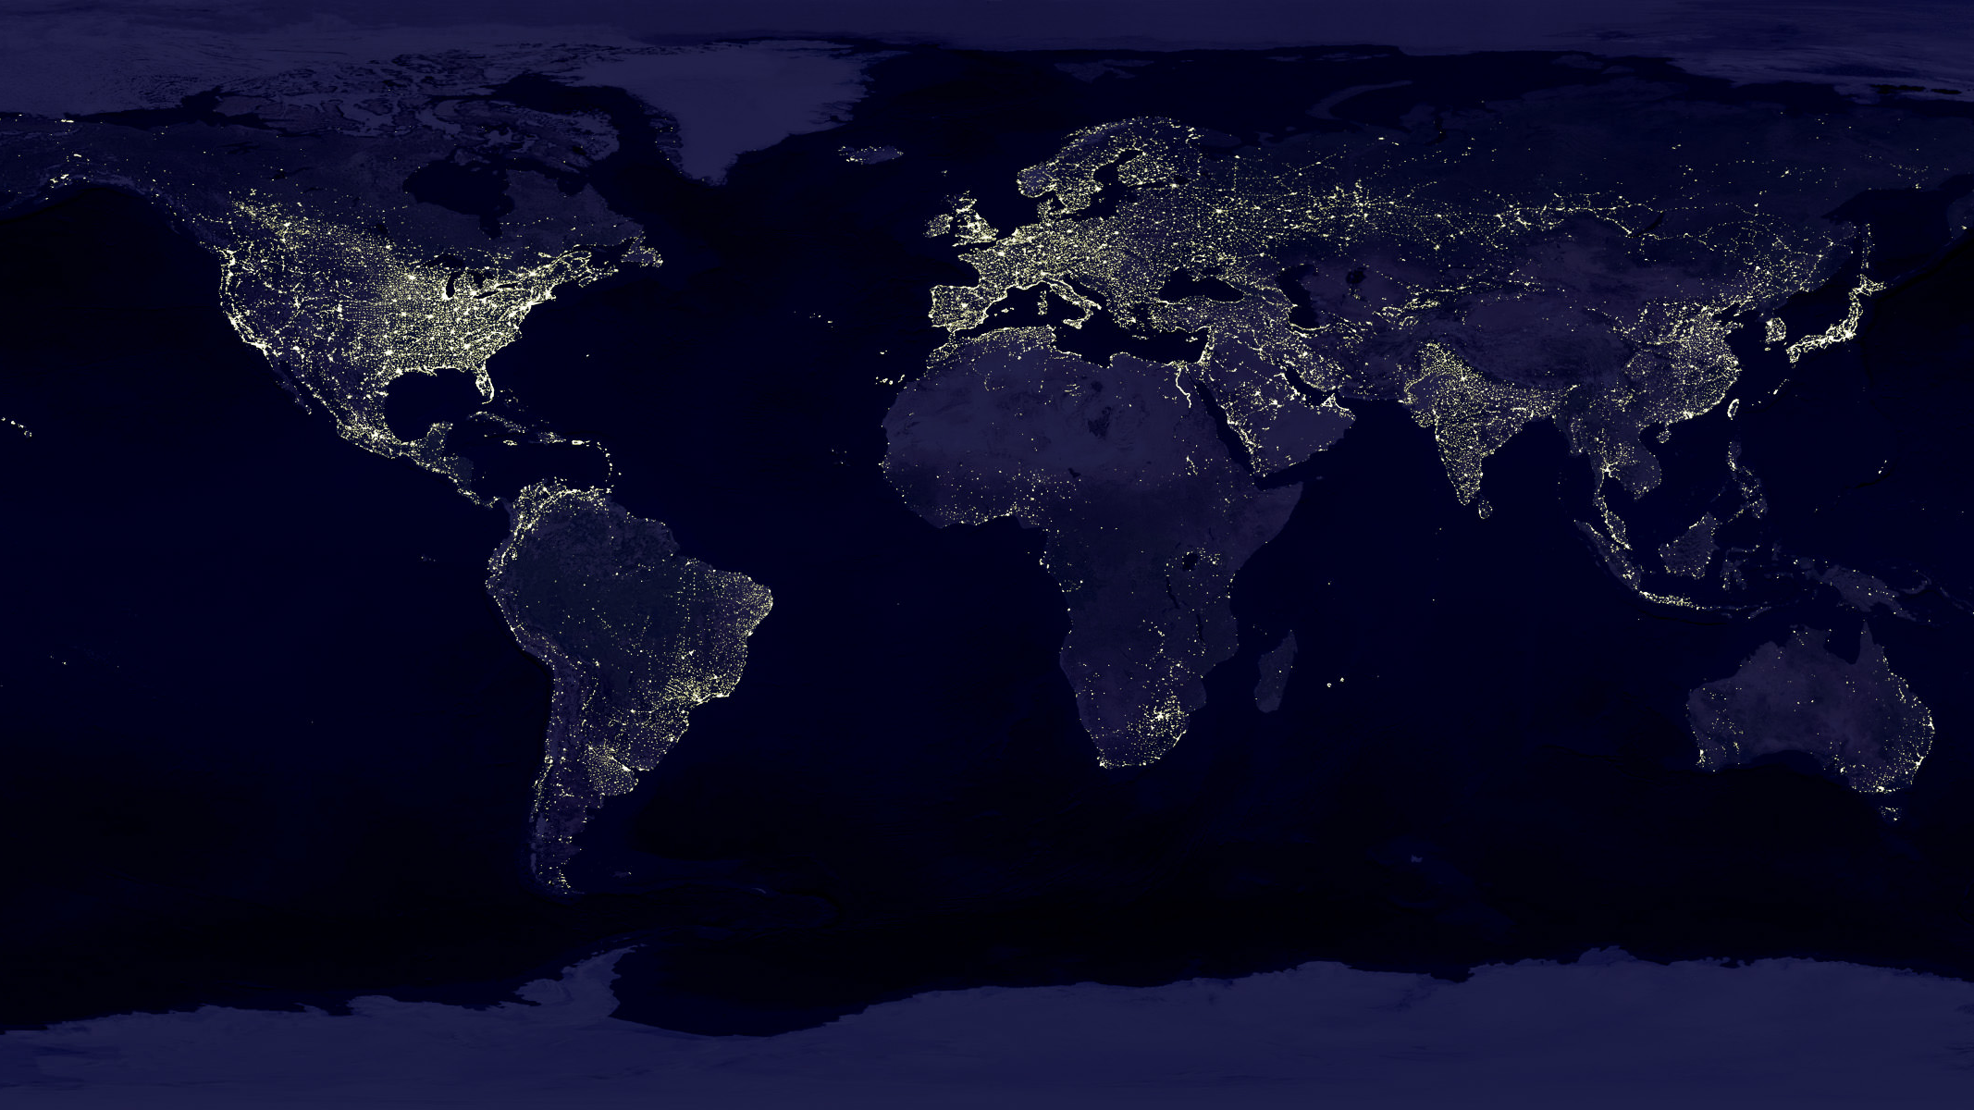

Indira Gandhi National Open University Topic : Animals Everywhere Subject : English Class : Fifth Name : Abhishek Kumar Ojha Session : 2019 - 22

Slide 2
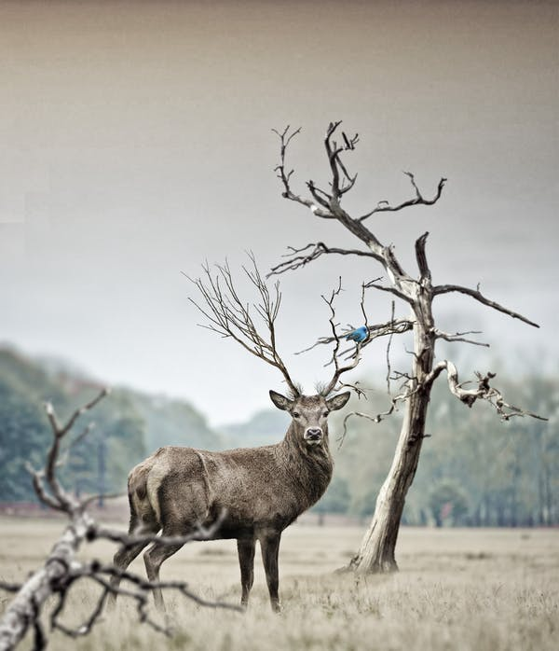
Agenda
Introduction
Habitat
Type of Habitats in our Planet
Different body covering in animals
Different Habits in animals

Slide 3
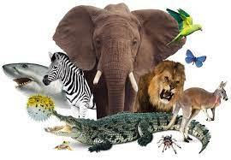
Introduction
Our planet is home to animals which live in different types of surroundings like forests, rivers, ponds, mountains, gardens, deserts, and even in our homes. Animals form a diverse group of living organisms. They play a very important role in our life.

Slide 4
Habitat
Different types of animals grow and survive in different natural surroundings. The surroundings in which an animal lives and survives is called its habitat. Animals are found in a variety of habitats ranging from dry desert to lush green forests.

Slide 5
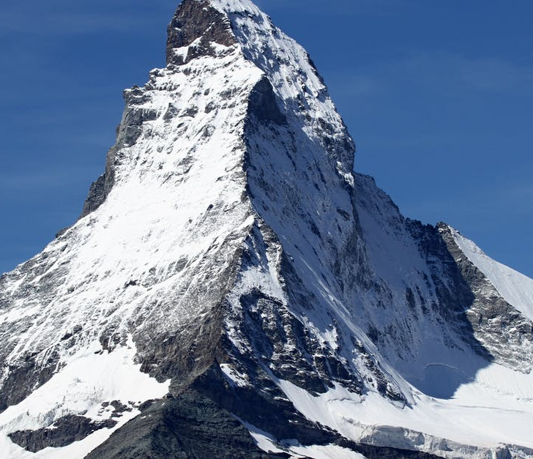
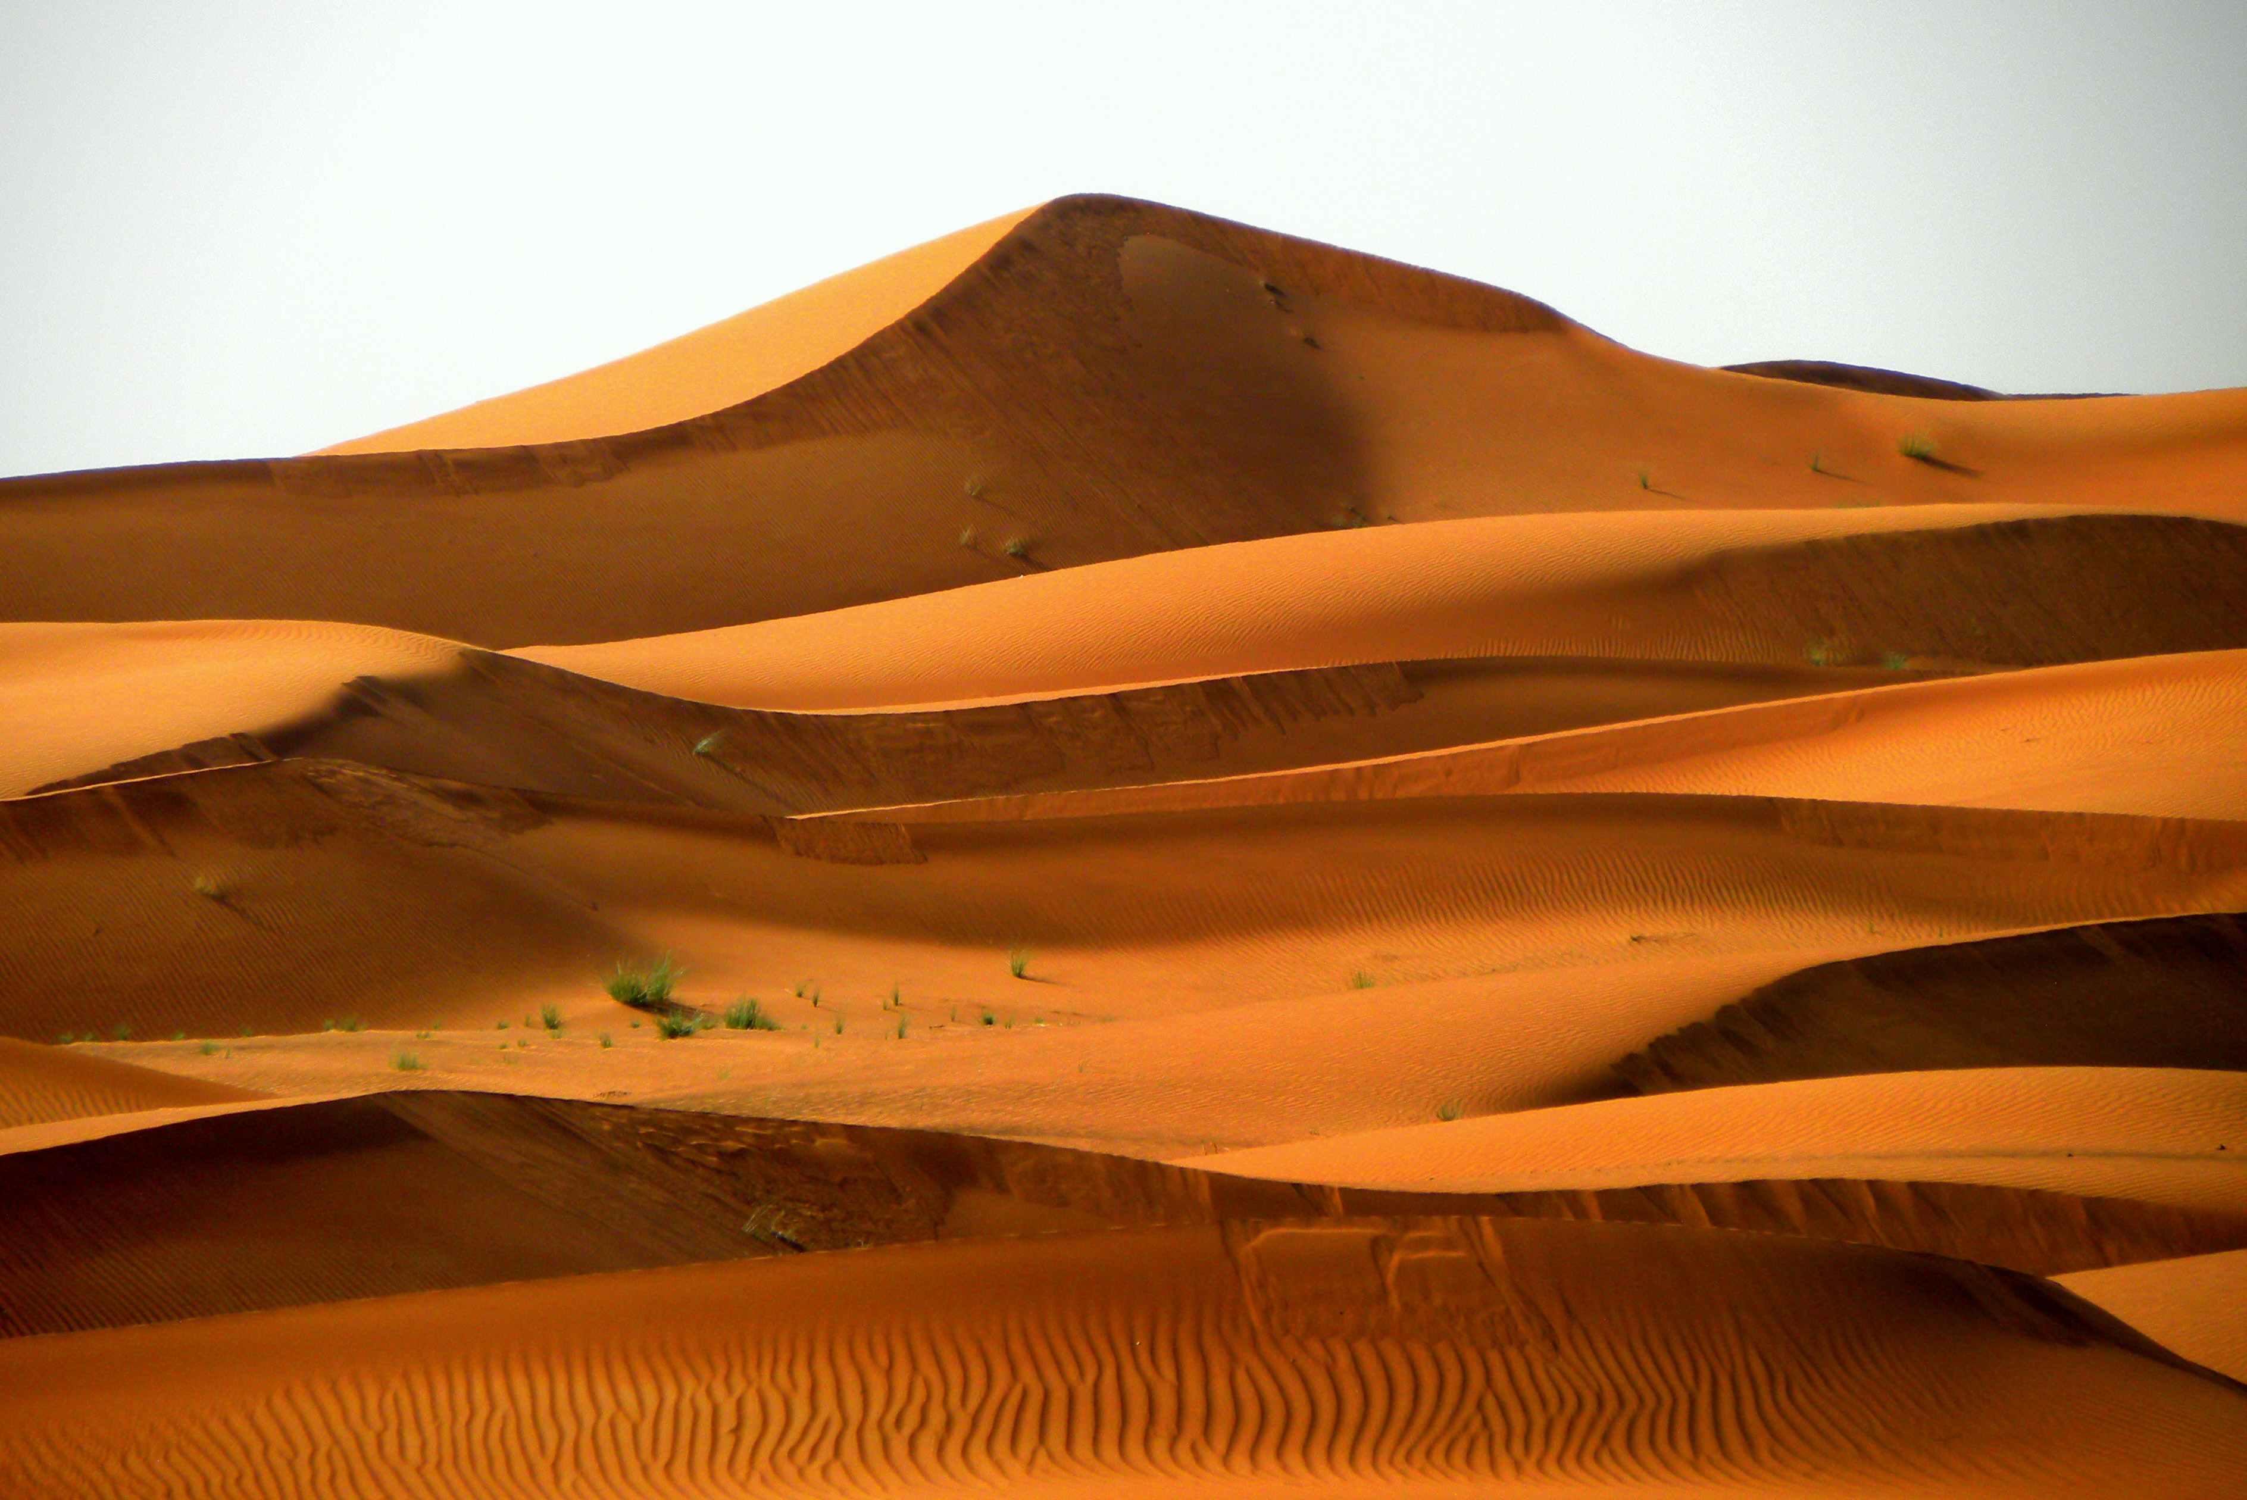
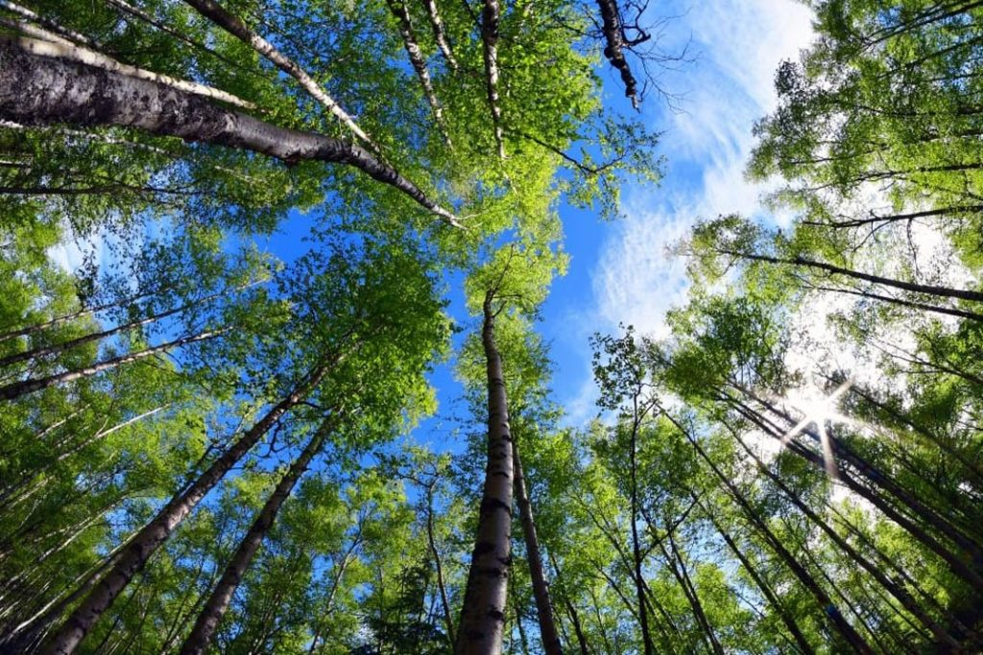


Types of Habitat in our Planet
Mountain
Desert
Forest
Freshwater
Ocean

Slide 6
Different body covering in animals
Body covering of different animals varies according to their natural habitat. Different animals have different types of body covering for their protection. The outer layer which is used for protection is called as body coverings. It acts as the animal’s first line of defense from any danger.

Slide 7
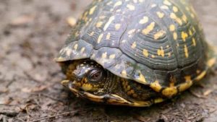
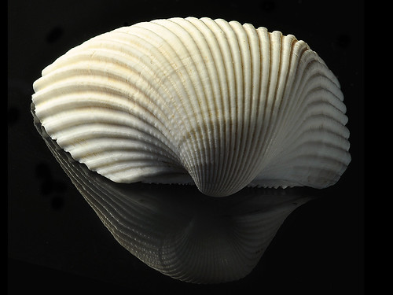
Shells
It is a hard protective outer covering in animals like snails, tortoises and turtles.
It protects their soft bodies from injuries and attacks .

Slide 8
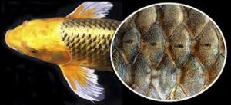
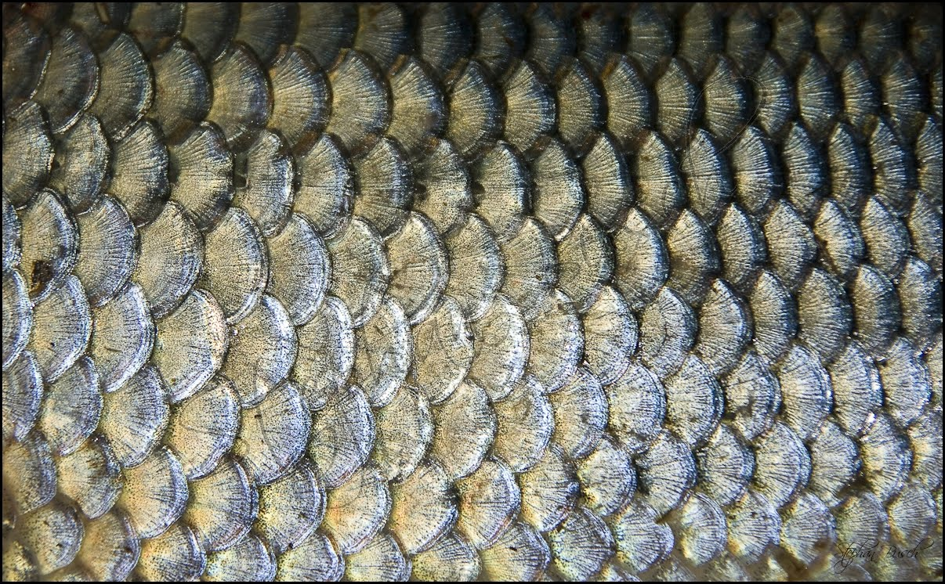
Scales
It is a hard body covering that protects the animals from the predator and the weather.
It is present in both reptiles and fishes.

Slide 9
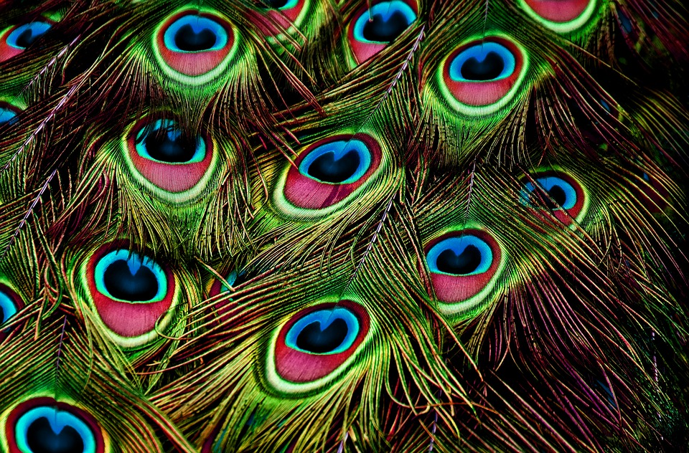
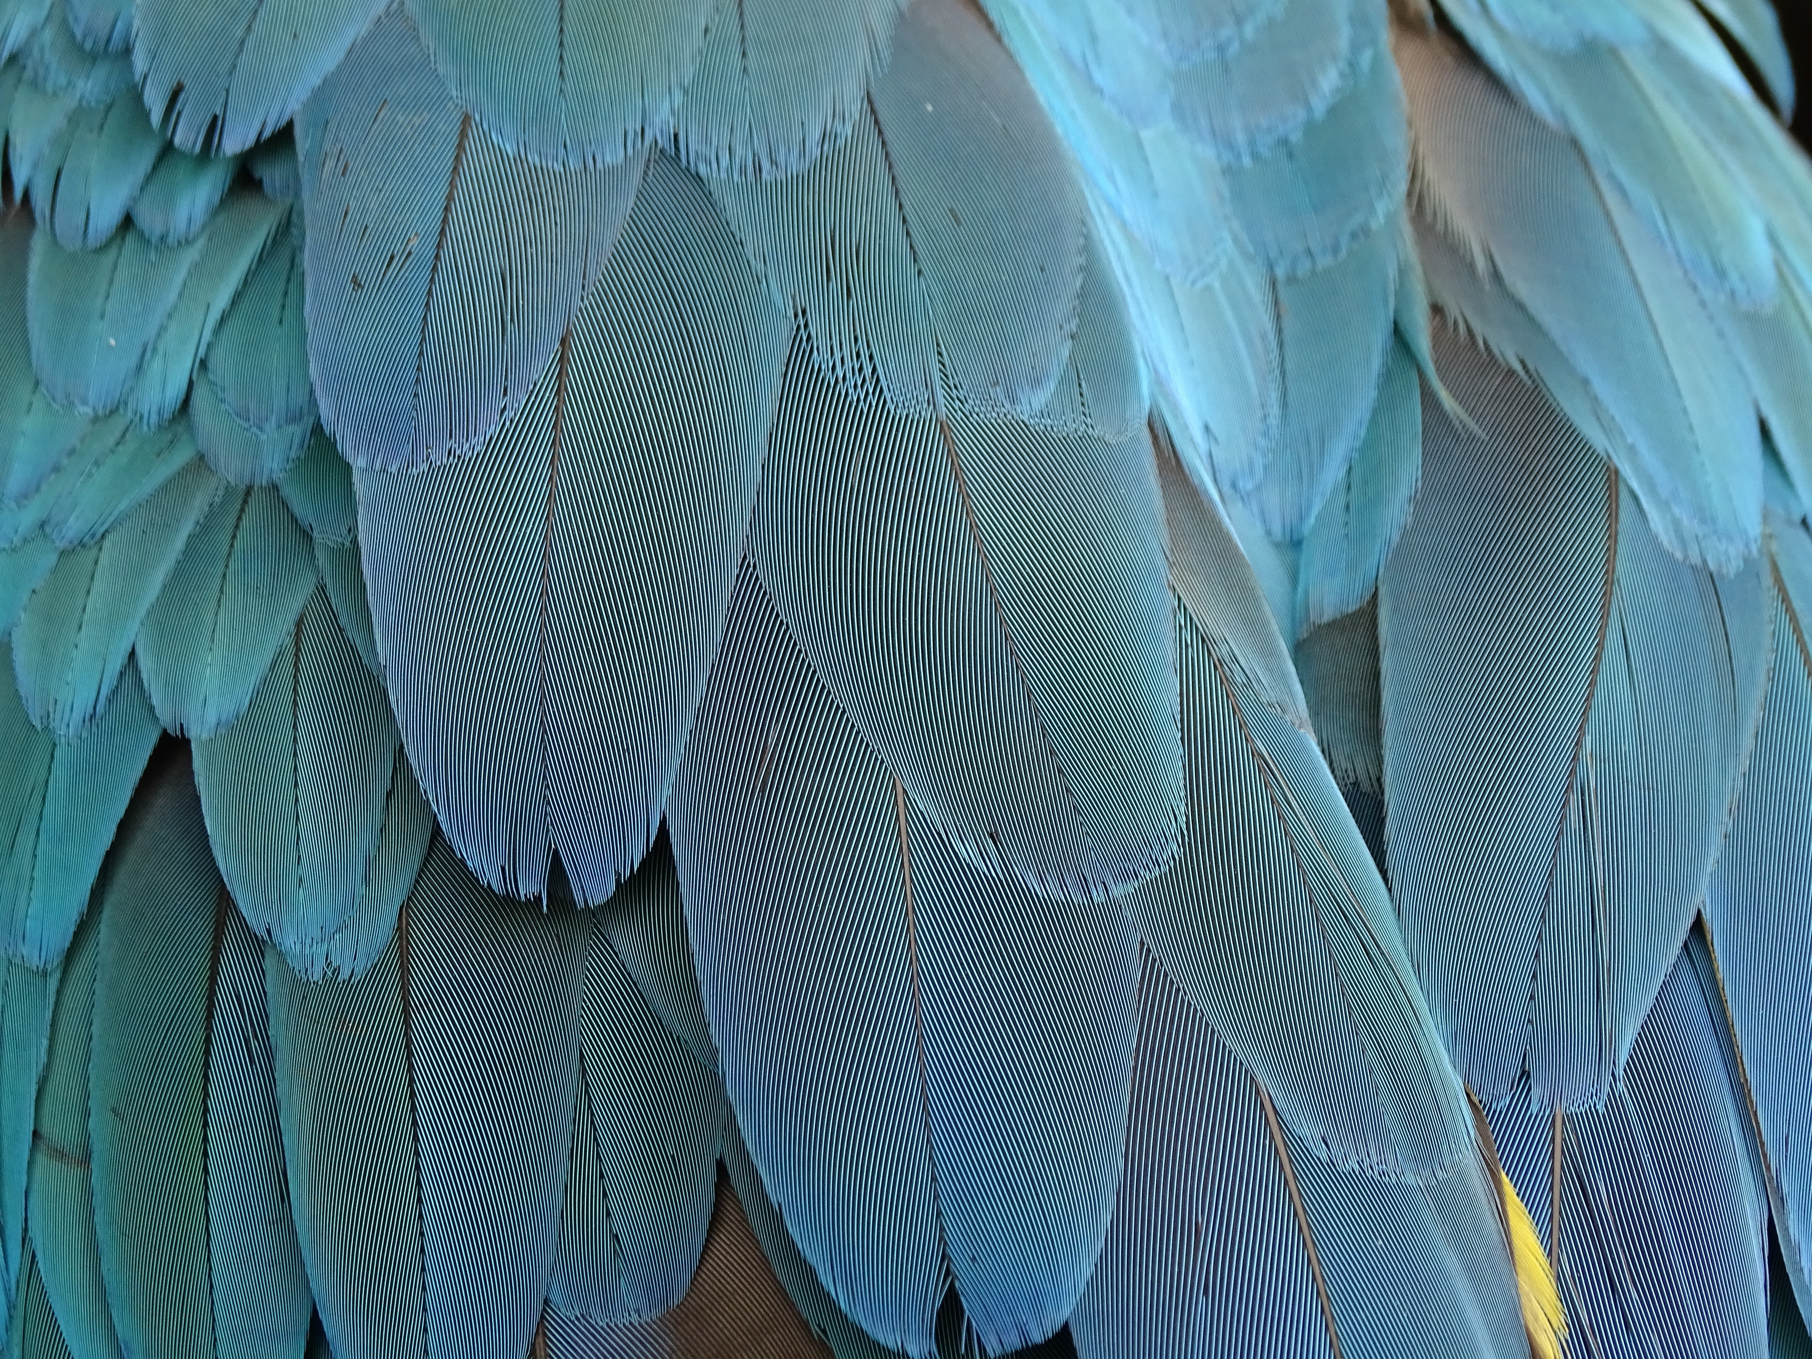
Feathers
This body covering is found in birds which help them keep warm and helps them to fly.
They also help them during rain.

Slide 10
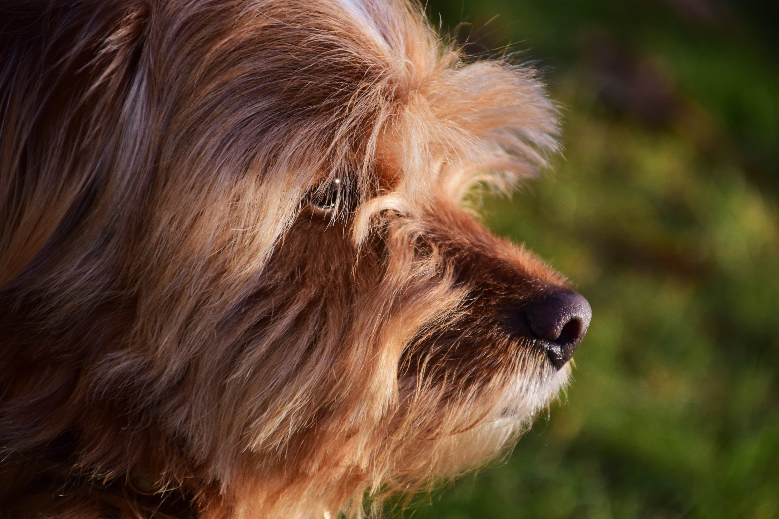
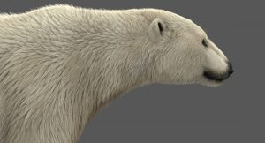
Hair/fur
Mammals have a body covering of hair which helps them keep warm and stay safe from enemies.

Slide 11
Different eating habits in animals
Like all other living organisms , animals also need food in order to grow, get energy and stay healthy.
Food provides the energy to perform all activities.
Different animals eat different types of food to stay alive.

Slide 12
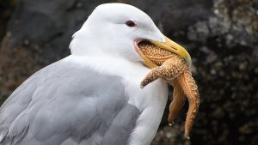
Birds
Birds have beaks/claws with the help of which they catch and hold their food .
Birds have different shapes and sizes of beaks depending on the type of food they eat.

Slide 13
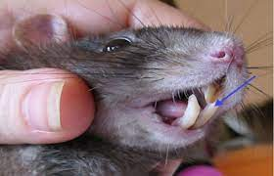
Rodent
Rodents like rabbits, mice and squirrels have small sharp front teeth to gnaw nuts, seeds and fruits.

Slide 14
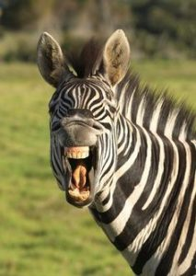
Herbivore
They have sharp flat front teeth to bite their food.
Their strong broad grinding teeth at the back helps them in grinding the grass and leaves.

Slide 15
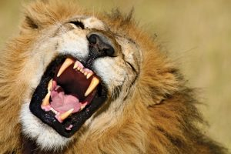
Carnivore
hey have long, sharp and pointed front teeth for tearing flesh .
Their strong grinding teeth at the back helps them in chewing the bones and flesh.

Slide 16

The End
Thanks to Vandana Mam for giving me the opportunity to make the Project.

